Slide 1
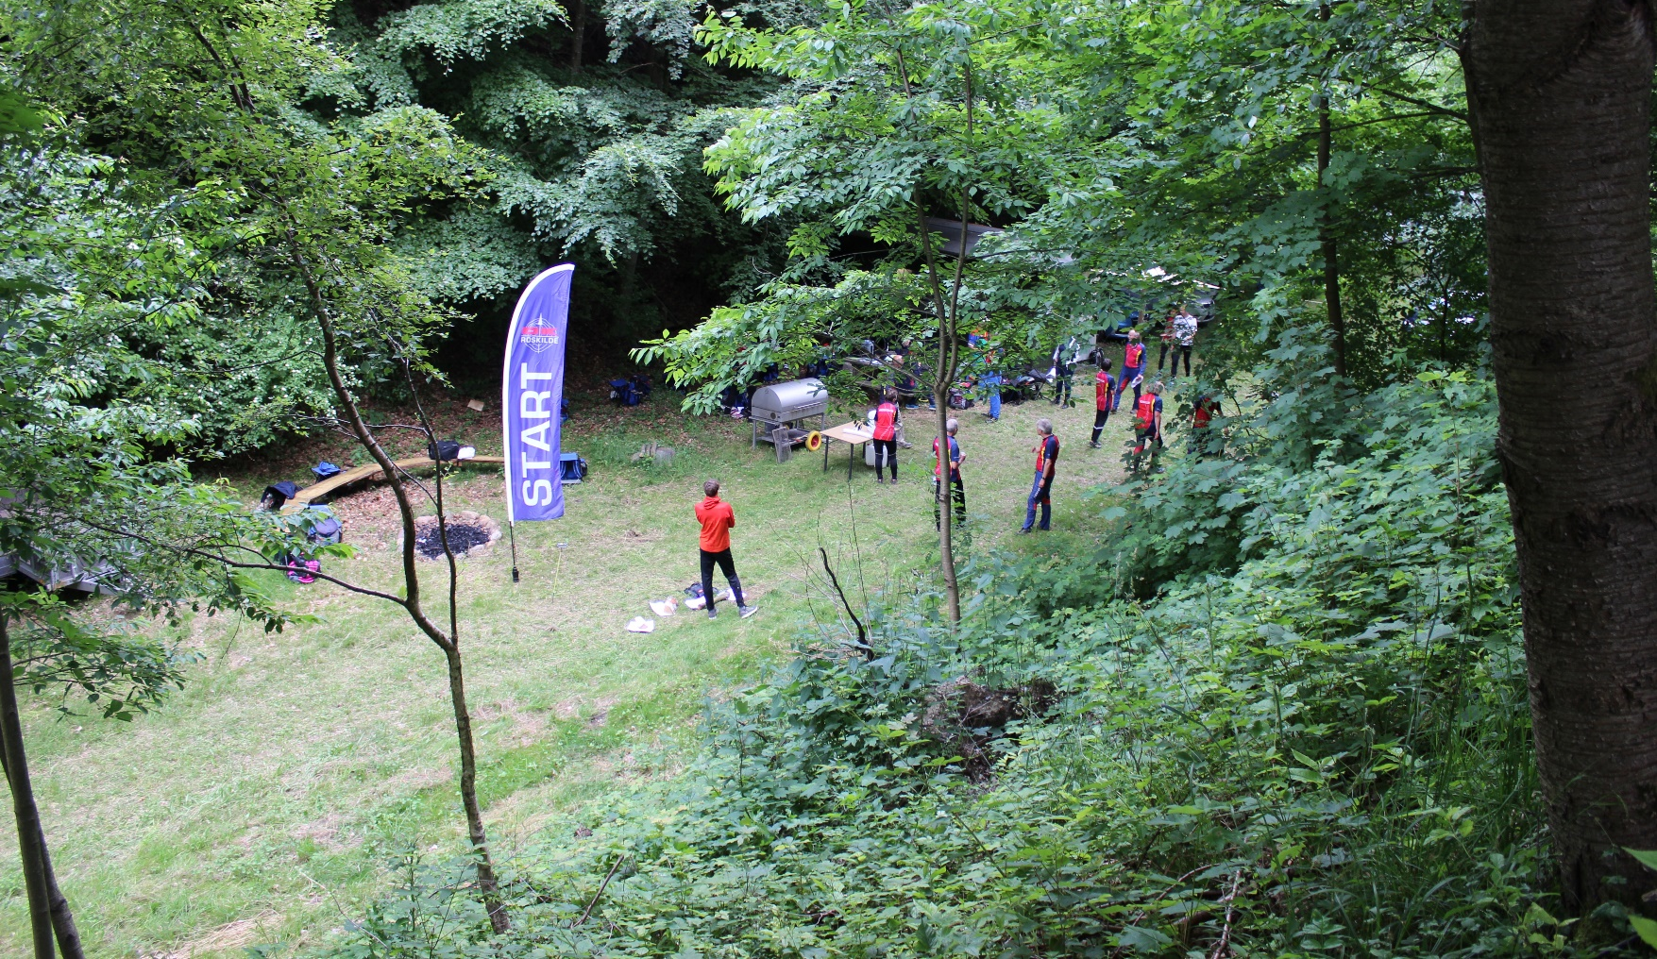
Sustainability work in national Olympic committee of denmark

Slide 2
About noc of Denmark
62 National Federations
9.000 clubs
Almost 2 mio members (a third of the total population)

Slide 3
About noc of denmark
Having a third of the population as members commits us to take responsibility towards society

Slide 4
Noc of Denmark environmental history
In 1997 an Environmental Code of Conduct was adopted by the General Assembly
In 1998 an Environmental Award was established for 10 years
In 2010 an Environmental Certification of NF was introduced

Slide 5
All these years The task was environmental…
but we tried all along to consider all three aspects of sustainability
Social
Economic
Environmental

Slide 6
Now with the sdg
We have found a common language to express what needs to be done to create a better world.
Inspired by the IOC we offered the SDG full attention in 2018:

Slide 7
We asked, how do we play along?
Kick-off conference with focus on three goals:
Nr.5 Gender equality
Nr.11 Sustainable cities and communities
Nr.16 Peace, justice and strong institutions

Slide 8
We didn’t want greenwashing:
As former Danish Minister for Environment said:
“The SDG are not a list of goals to be crossed off one by one. They are an agenda for change.”
Kirsten Brosbøl

Slide 9
we took some important steps:
Our General Assembly adopted a new political programme with goaIs for sustainability
We signed “Sports for Climate Action Framework”
Joined the ASAP project

Slide 10
About Sports for climate action framework – S4CA
Leads and supports working groups
Brings expertise and best practices
Provides us – and you – with tools

Slide 11
About Sports for climate action framework – S4CA
The signatories commit to five principles:
Principle 1: “Undertake systematic efforts to promote greater environmental responsibility”

Slide 12
What does that mean?
The challenge must be met systematically!
What we all need to do is:
Start measuring our climate footprint – IOC and ANOC will help
Plan how to bring it down
Act!

Slide 13
About the ASAP project
Mentor-mentee cooperation:
Finland – Hungary
Germany – Czech Republic
Denmark – Slovakia
In cooperation with IOC

Slide 14
Asap partners
Help each other to move from ad hoc projects to systematic efforts
Develop educational material for other sports organizations
Create mentors out of mentees

Slide 15
Sustainability is an investment in your future economy:
Brings direct savings (energy, water etc.)
Brings efficiencies (sourcing, re-using)
Minimizes waste
Optimizes lifetime values of goods

Slide 16
We are in it together and no one can row the boat alone

Slide 17
That means that no person can do this alone
It is crucial with involvement and to encourage everybody at all levels in your organization to make it a sport to reduce your carbon footprint.
Maybe a workshop for staff members will be a good start for your organization?

Slide 18
Thank you for your attention – the ball is yours!

